Slide 2
Edit this text to create a title slide
And put your sub-heading here

Slide 3
Title of your slide here Helvetica, Black, Bold, 28 points
This font is Helvetica
This text is 24 points
This font colour is Grey (Text 1, Black, Lighter 15% or R38 G38 B38)
Bullets are the same colour as font colour
Longer bullets in the form of a paragraph are difficult to read if there is insufficient line spacing
The maximum recommended number of lines in each slide is approximately seven
Sub-bullets look like this
And this

Slide 4
Title of your slide here Helvetica, Black, Bold, 28 points
This font is Helvetica
This text is 22 points
This font color is Grey (Text 1, Black, Lighter 15% or R38 G38 B38)
Bullets are the same color as font color
This slide is designed for text on left, graphic on right
You may use this slide for text accompanied with graphs, charts, figures, graphics, etc.

Slide 5
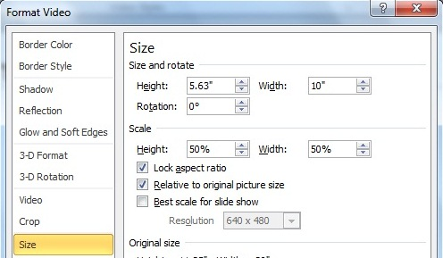
Title of your slide here Helvetica, Black, Bold, 28 points
The following are specs for inserting video files in your PowerPoint presentation:

